Slide 1
INTRODUCTION TO COMPUTER NETWORKS

Slide 2
Computer Networks
A large number of separate but interconnected computers are called computer networks.
Two computers are said to be interconnected if they are able to exchange information.

Slide 3
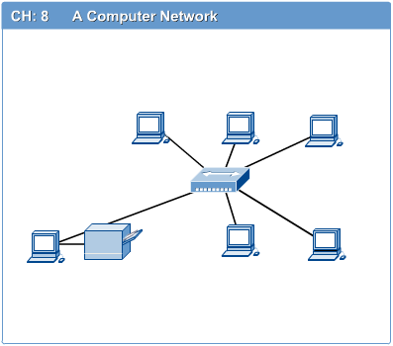
Fig: computer network

Slide 4
Computer network connects two or more autonomous computers.
The computers can be geographically located anywhere.
Networks come in many sizes, shapes and forms.

Slide 5
Computer network and distributed system.
The key distinction is that in a distributed system, a collection of independent computers appears to its users as a single coherent system.
Usually, it has a single model or paradigm that it presents to the users. Often a layer of software on top of the operating system, called middleware, is responsible for implementing this model.
A well-known example of a distributed system is the World Wide Web. It runs on top of the Internet and presents a
model in which everything looks like a document (Web page).

Slide 6
In a computer network, this coherence, model, and software are absent.
Users are exposed to the actual machines, without any attempt by the system to make the machines look and act in a coherent way.
If the machines have different hardware and different operating systems, that is fully visible to the users.
If a user wants to run a program on a remote machine, he† has to log onto that machine and run it there.

Slide 7
In a nut shell we can say that a distributed system is a software system built on top of a network.

Slide 8
Uses of Computer Networks
Business Applications
Home Applications
Mobile Users
Social Issues

Slide 9
Applications of Networks
Resource Sharing
Hardware (computing resources, disks, printers)
Software (application software)
Information Sharing
Easy accessibility from anywhere (files, databases)
Search Capability (WWW)
Communication
Email
Message broadcast
Remote computing
Distributed processing (GRID Computing)

Slide 10
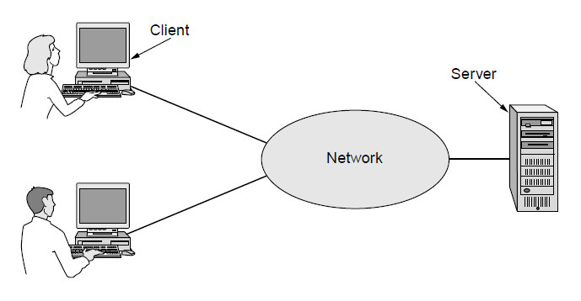
Business Applications (1)
A network with two clients and one server

Slide 11
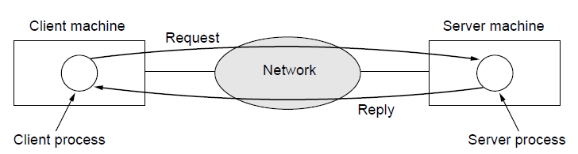
Business Applications (2)
The client-server model involves requests and replies

Slide 12
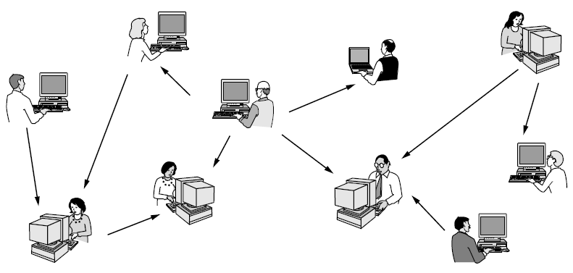
Home Applications (1)
In a peer-to-peer system there are no fixed clients and servers.

Slide 13
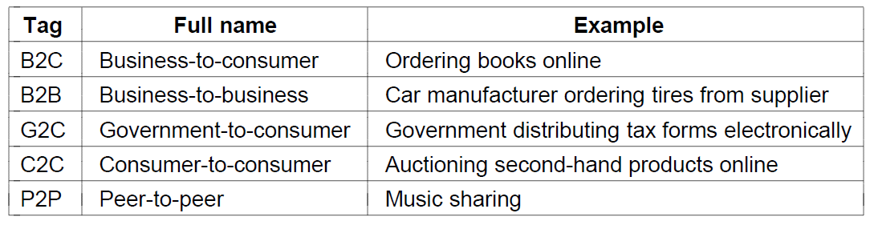
Home Applications (2)
Some forms of e-commerce

Slide 14
Mobile Users
Combinations of wireless networks and mobile computing

Slide 15
Social Issues
Network neutrality
Digital Millennium Copyright Act
Profiling users
Phishing

Slide 16
Network Hardware
There are two types of transmission technology that are in widespread use: broadcast links and point-to-point links.

Slide 17
Point-to-point links connect individual pairs of machines.
To go from the source to the destination on a network made up of point-to-point links, short messages, called packets in certain contexts, may have to first visit one or more intermediate machines.
Often multiple routes, of different lengths, are possible, so finding good ones is important in point-to-point networks.
Point-to-point transmission with exactly one sender and exactly one receiver is sometimes called unicasting

Slide 18
In contrast, on a broadcast network, the communication channel is shared by all the machines on the network; packets sent by any machine are received by all the others.
An address field within each packet specifies the intended recipient.
Upon receiving a packet, a machine checks the address field. If the packet is intended for the receiving machine, that machine processes the packet; if the packet is intended for some other machine, it is just ignored.

Slide 19
Unicast
Broadcast
Multicast

Slide 20
categories
Wired
Wireless

Slide 21
Types
Personal area networks
Local area networks
Metropolitan area networks
Wide are networks
The internet

Slide 22
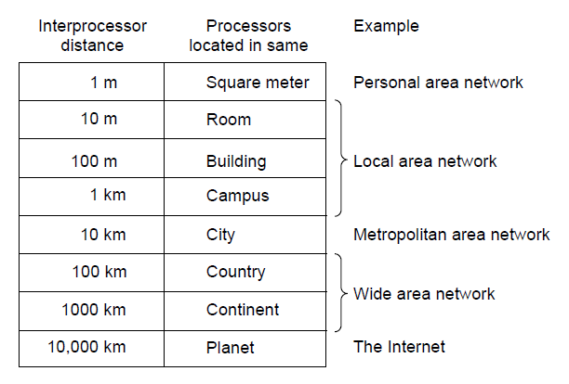
Classification of interconnected processors by scale.

Slide 23
Personal area networks
PANs (Personal Area Networks) let devices communicate over the range of a person.
A common example is a wireless network that connects a computer with its peripherals.
Almost every computer has an attached monitor, keyboard, mouse, and printer. Without using wireless, this connection must be done with cables.

Slide 24
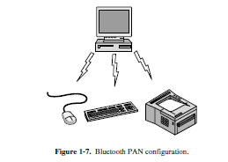

Slide 25
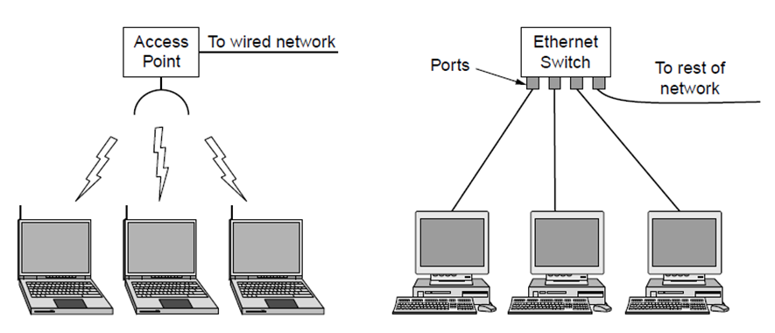
Local Area Networks
Wireless and wired LANs. (a) 802.11. (b) Switched Ethernet.

Slide 26
A LAN is a privately owned network that operates within and near by a single building like a home, office or factory.
When LANs are used by companies, they are called enterprise networks
Wired LAN
Wireless LAN

Slide 27
There is a standard for wireless LANs called IEEE 802.11, popularly known as WiFi, which has become very widespread.
It runs at speeds anywhere from 11 to hundreds of Mbps.
Wired LANs use a range of different transmission technologies. Most of them use copper wires, but some use optical fiber.
LANs are restricted in size, which means that the worst-case transmission time is bounded and known in advance.
Typically, wired LANs run at speeds of 100 Mbps to 1 Gbps.

Slide 28
Newer LANs can operate at up to 10 Gbps. Compared to wireless networks, wired LANs exceed them in all dimensions of performance.
It is just easier to send signals over a wire or through a fiber than through the air.

Slide 29
The topology of many wired LANs is built from point-to-point links.
IEEE 802.3, popularly called Ethernet, is, by far, the most common type of wired LAN.

Slide 30
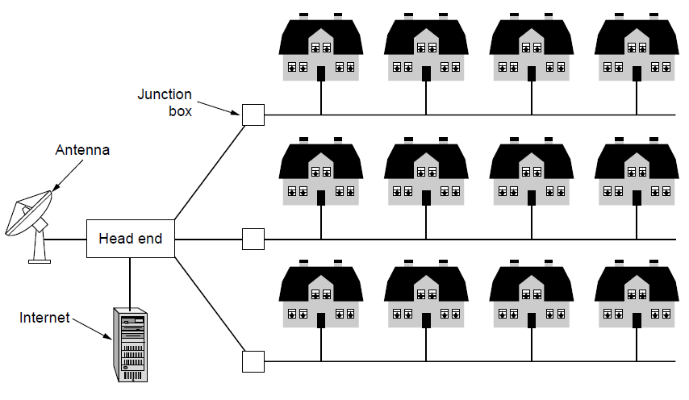
Metropolitan Area Networks
A metropolitan area network based on cable TV.

Slide 31
A MAN (Metropolitan Area Network) covers a city. The best-known examples of MANs are the cable television networks available in many cities.
Initially MAN is used for Cable transmission. Now it is mixed with internet
Both television signals and Internet being fed into the centralized cable headend for subsequent distribution to people’s homes.
Internet access have resulted in another MAN, which has been standardized as IEEE 802.16 and is popularly known as WiMAX.
(Worldwide Interoperability for Microwave Access).

Slide 32
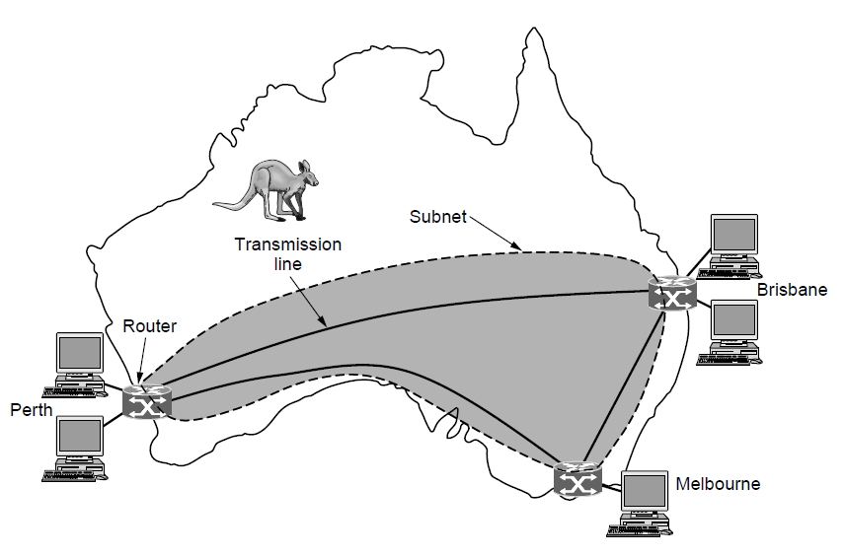
Wide Area Networks (1)
WAN that connects three branch offices in Australia

Slide 33
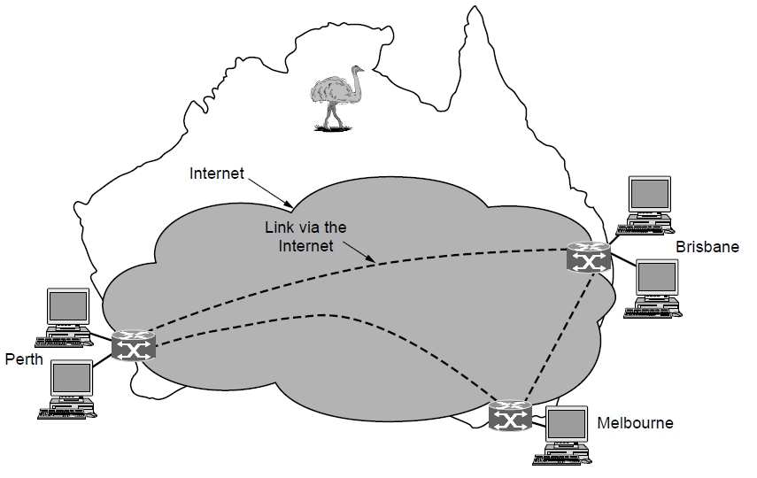
Wide Area Networks (2)
WAN using a virtual private network.

Slide 34
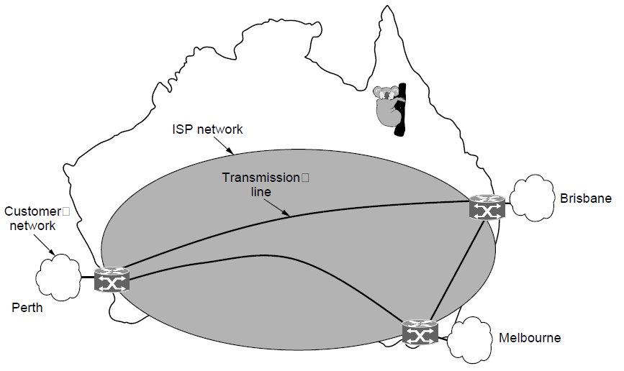
Wide Area Networks (3)
WAN using an ISP network.

Slide 35
Internetworks
A collection of interconnected networks is called an internetwork or internet.
The term ‘‘subnet’’ makes the most sense in the context of a wide area network, where it refers to the collection of routers and communication lines owned by the network operator
A network is formed by the combination of a subnet and its hosts.

Slide 36
We know that an internet is formed when distinct networks are interconnected.
In our view, connecting a LAN and a WAN or connecting two LANs is the usual way to form an internetwork, but there is little agreement in the industry over terminology in this area.

Slide 37
The general name for a machine that makes a connection between two or
more networks and provides the necessary translation, both in terms of hardware and software, is a gateway.

Slide 38
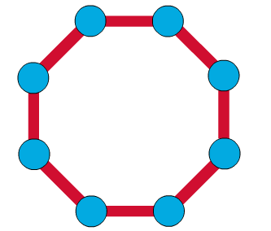
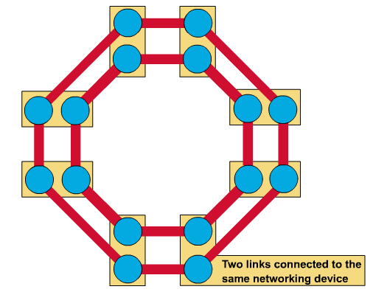
Ring Topology
A frame travels around the ring, stopping at each node. If a node wants to transmit data, it adds the data as well as the destination address to the frame.
The frame then continues around the ring until it finds the destination node, which takes the data out of the frame.
Single ring – All the devices on the network share a single cable
Dual ring – The dual ring topology allows data to be sent in both directions.

Slide 39
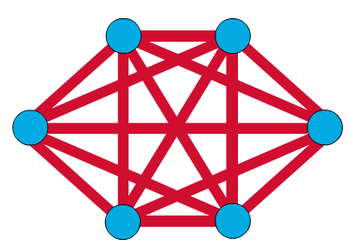
Mesh Topology
The mesh topology connects all devices (nodes) to each other for redundancy and fault tolerance.
It is used in WANs to interconnect LANs and for mission critical networks like those used by banks and financial institutions.
Implementing the mesh topology is expensive and difficult.

Slide 40
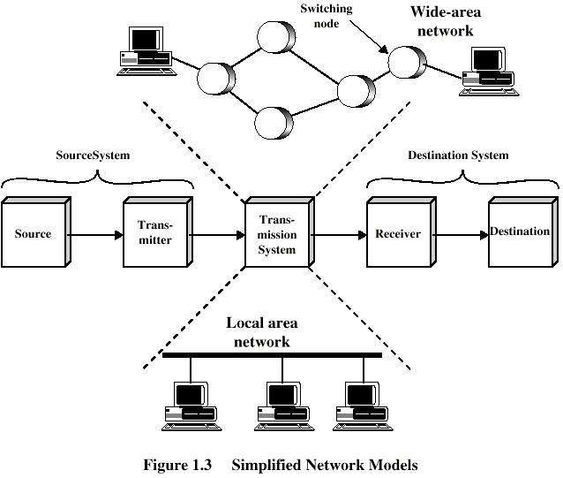
Simplified Network Model

Slide 41
Network Software
Protocol hierarchies
Design issues for the layers
Connection-oriented versus connectionless service
Service primitives
Relationship of services to protocols

Slide 42
Protocols
Set of rules that govern data communication
Used for communications between entities in a system
Entities
User applications
e-mail facilities
terminals
Systems
Computer
Terminal
Remote sensor

Slide 43
Protocol Architecture
Task of communication broken up into modules
For example file transfer could use three modules
File transfer application
Communication service module
Network access module
Key elements of a protocol are syntax, semantics and it’s timing.

Slide 44
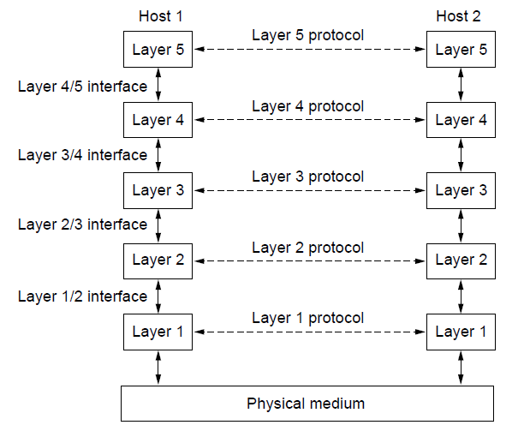
Protocol Hierarchies (1)
Layers, protocols, and interfaces.

Slide 45
Layers can offer two different types of services to the layers above them.
Connection oriented
Connection less
Connection oriented service is modeled after the telephone system.
To talk to some one you pick up the phone,dial the number, talk and then hang up.
In connection oriented service
1. establish a connection
2. use the connection
3. release the connection.

Slide 46
Connection less
Is modeled after the postal system.
Each message(letter) carries the full designation address and each one is routed to the system independent of all others.

Slide 47
Message sequence
Byte streams

Slide 48
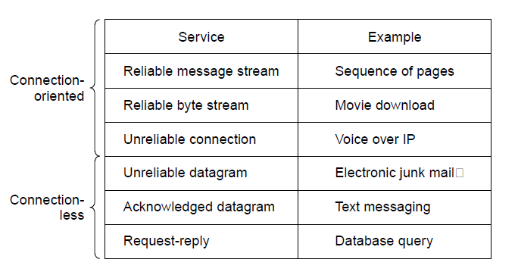
Connection-Oriented Versus Connectionless Service
Six different types of service.

Slide 49
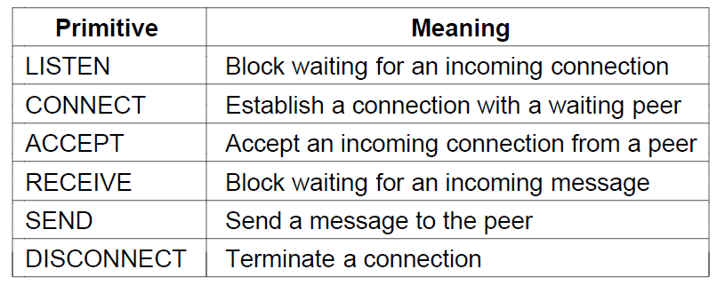
Service Primitives (operations)
Six service primitives that provide a simple connection-oriented service
Primitives are different for connection oriented and connection less.

Slide 50
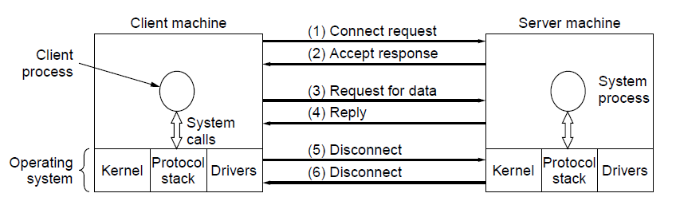
Service Primitives
A simple client-server interaction using acknowledged datagrams.

Slide 51
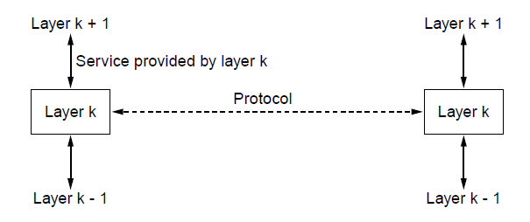
The Relationship of Services to Protocols
The relationship between a service and a protocol.

Slide 52
Service is a set of primitives that a layer provides to the layer above it.
A service relates to an interface between two layers, with the lower layer being the service provider and the upper layer being the service user.
Entities use protocols to implement their service definitions.

Slide 53
Reference Models
OSI reference model
TCP/IP reference model
Model used
Comparison of OSI and TCP/IP
Critique of OSI model and protocols
Critique of TCP/IP model

Slide 54
The OSI Reference Model
Principles for the seven layers
Layers created for different abstractions
Each layer performs well-defined function
Function of layer chosen with definition of international standard protocols in mind
Minimize information flow across interfaces between boundaries
Number of layers optimum

Slide 55
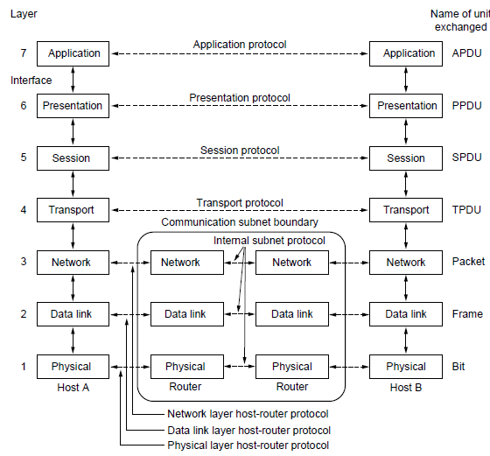
The OSI Reference Model
The OSI reference model

Slide 56
OSI Reference Model Layers
Physical layer
Data link layer
Network layer
Transport layer
Session layer
Presentation layer
Application layer

Slide 57
Physical (Layer 1)
This layer conveys the bit stream - electrical impulse, light or radio signal — through the network at the electrical and mechanical level.
It provides the hardware means of sending and receiving data on a carrier, including defining cables, cards and physical aspects

Slide 58
Data Link (Layer 2)
At this layer, data packets are encoded and decoded into bits. It furnishes transmission protocol knowledge and management and handles errors in the physical layer, flow control and frame synchronization.

Slide 59
Network (Layer 3)
This layer provides switching and routing technologies, creating logical paths, known as virtual circuits, for transmitting data from node to node

Slide 60
Transport (Layer 4)
This layer provides transparent transfer of data between end systems, or hosts, and is responsible for end-to-end error recovery and flow control. It ensures complete data transfer.

Slide 61
Session (Layer 5)
This layer establishes, manages and terminates connections between applications.

Slide 62
Presentation (Layer 6)
This layer provides independence from differences in data representation (e.g., encryption) by translating from application to network format, and vice versa

Slide 63
Application (Layer 7)
This layer supports application and end-user processes. Communication partners are identified, quality of service is identified, user authentication and privacy are considered,

Slide 64
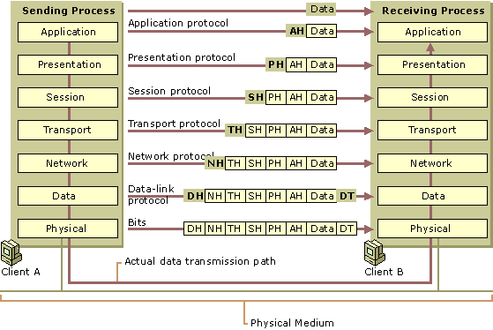
Data Flow in the OSI Model

Slide 65
The TCP/IP Reference Model Layers
Link layer
Internet layer
Transport layer
Application layer

Slide 66
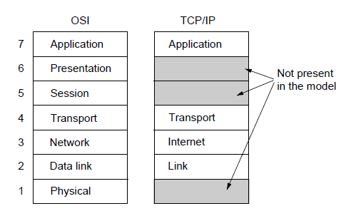
The TCP/IP Reference Model (1)
The TCP/IP reference model

Slide 67
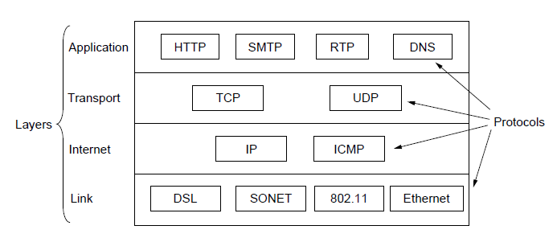
The TCP/IP Reference Model (2)
The TCP/IP reference model with some protocols we will study

Slide 68
RTP: real time transport protocol
DNS : domain name Systems
I CMP: The Internet Control Message Protocol
DSL (Digital Subscriber Line)
Synchronous Optical Networking (SONET)

Slide 69
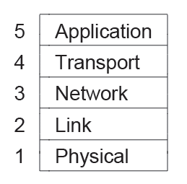
The Model Used in this Book
The reference model used in this book.

Slide 70
Comparison of the OSI and TCP/IP Reference Models
Concepts central to OSI model
Services
Interfaces
Protocols

Slide 71
Critique of the OSI Model and Protocols
Bad timing.
Bad technology.
Bad implementations.
Bad politics.

Slide 72
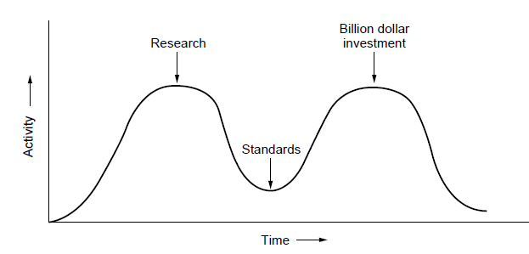
OSI Model Bad Timing
The apocalypse of the two elephants.

Slide 73
Example Networks
Internet
ARPANET
NSFNET
Third-generation mobile phone networks
Wireless LANs: 802.11
RFID and sensor networks

Slide 74
NOVELL NETWARE
NetWare is a computer network operating system developed by Novell, Inc. It initially used cooperative multitasking to run various services on a personal computer, using the IPX network protocol.
NetWare evolved from a very simple concept: file sharing instead of disk sharing

Slide 75
NetWare, made by Novell, is a widely-installed network server operating system.
Initially very successful in installing its products in large and small office local area networks (LANs),
Novell redesigned (or at least refeatured) NetWare to work successfully as part of larger and heterogeneous networks, including the Internet.
A early - and primary competitor was the Microsoft Windows NT operating system.

Slide 76
The Data Link Layer

Slide 77
FRAMING
The data link layer needs to pack bits into frames, so that each frame is distinguishable from another.
Our postal system practices a type of framing.

Slide 78
Data Link Layer Design Issues
Network layer services
Framing
Error control
Flow control

Slide 79
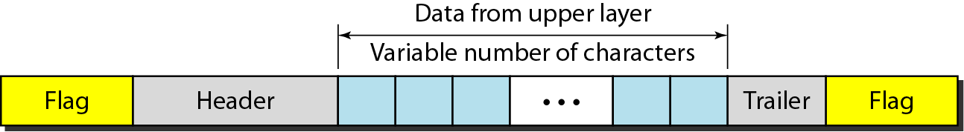
A frame in a character-oriented protocol

Slide 80
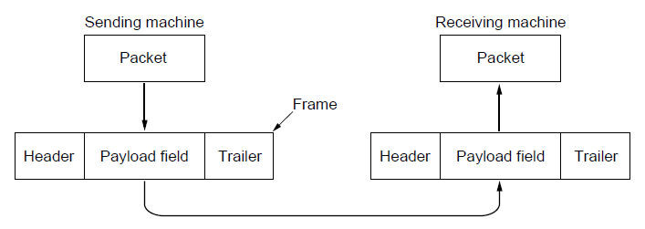
Packets and Frames
Relationship between packets and frames.

Slide 81
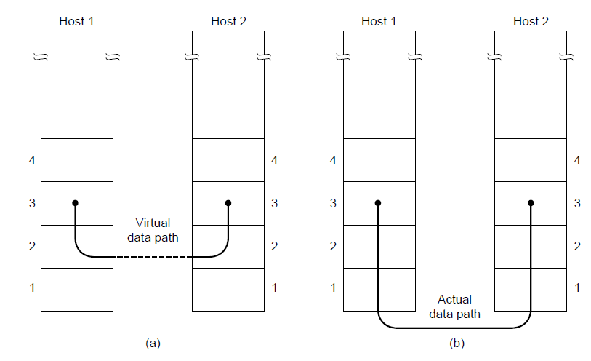
Network Layer Services
(a) Virtual communication. (b) Actual communication.

Slide 82
Possible Services Offered
Unacknowledged connectionless service.
Acknowledged connectionless service.
Acknowledged connection-oriented service.

Slide 83
Framing Methods
Byte count.
Flag bytes with byte stuffing.
Flag bits with bit stuffing

Slide 84
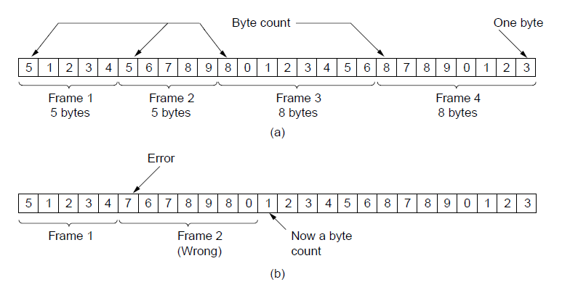
Framing (1)
A byte stream. (a) Without errors. (b) With one error.

Slide 85
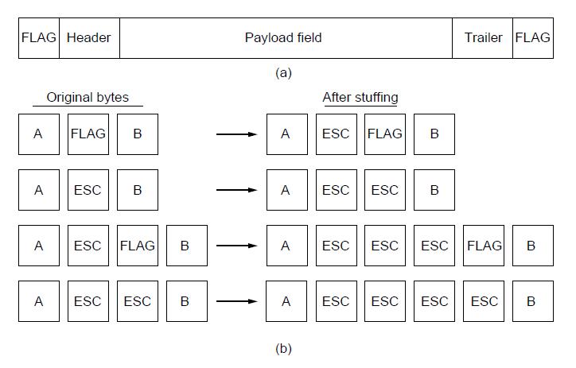
Framing (2)
A frame delimited by flag bytes.
Four examples of byte sequences before and after byte stuffing.

Slide 86
Byte stuffing is the process of adding 1 extra byte whenever there is a flag or escape character in the text.

Slide 87
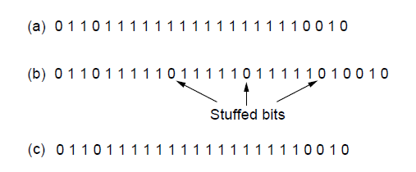
Framing (3)
Bit stuffing. (a) The original data. (b) The data as they appear on
the line. (c) The data as they are stored in the receiver’s memory after destuffing.

Slide 88
Bit stuffing is the process stuffing one extra 0 whenever five consecutive 1s are there in the data.

Slide 89
FLOW AND ERROR CONTROL
The most important responsibilities of the data link layer are flow control and error control. Collectively, these functions are known as data link control.

Slide 90

Note
Flow control refers to a set of procedures used to restrict the amount of data
that the sender can send before
waiting for acknowledgment.

Slide 91
Two approaches are commonly used.
In the first one, feedback-based flow control, the receiver sends back information to the sender giving it permission to send more data, or at least telling the sender how the receiver is doing.
In the second one, rate-based flow control, the protocol has a built-in mechanism that limits the rate at which senders may transmit data, without using feedback from the receiver.
Nic cards

Slide 92
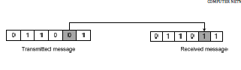
ERROR DETECTION AND CORRECTION
Types of errors:-
1. Single bit error: The term single-bit error means that only one bit of a given data unit is changed from 0 to 1 or 1 to 0.
Single bit error can happen only when we are sending data using parallel transmission.

Slide 93
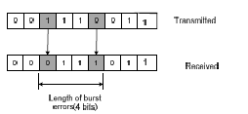
ERROR DETECTION AND CORRECTION
2. Burst error: The term burst error means that two or more bits in the data unit have changed from 1 to 0 or 0 to 1. Burst error is most likely to occur in a serial transmission.

Slide 94
Redundancy
To be able to detect or correct errors, we need to send some extra bits with our data. These redundant bits are added by the sender and removed by the receiver.
Their presence allows the receiver to detect or correct corrupted bits.

Slide 95
Detection Versus Correction
The correction of errors is more difficult than the detection. In error detection, we are looking only to see if any error has occurred.
In error correction, we need to know the exact number of bits that are corrupted and more importantly, their location in the message.
The number of the errors and the size of the message are important factors.

Slide 96
Forward Error Correction Versus Retransmission
There are two main methods of error correction. Forward error correction is the process in which the receiver tries to guess the message by using redundant bits.
This is possible, as we see later, if the number of errors is small. Correction by retransmission is a technique in which the receiver detects the occurrence of an error and asks the sender to resend the message.

Slide 97
ERROR DETECTION
The error detection uses the concept of redundancy, which means adding extra bits for
detecting errors at the destination.
They are discarded as soon as the accuracy of the transmission has been determined.
Three different error-detecting codes. They are all linear, systematic block codes:
1. Parity.
2. Checksums.
3. Cyclic Redundancy Checks (CRCs).

Slide 98
Parity check
Odd parity:
The number of 1-bit must add up to an odd number
Even parity:
The number of 1-bit must add up to an even number

Slide 99
Parity Bit
A single bit is appended to each data chunk
makes the number of 1 bits even/odd
Example: even parity
1000000(1)
1111101(0)
1001001(1)
Example: odd parity
1000000(0)
1111101(1)
1001001(0)

Slide 100
CRC
The CRC check is used to detect errors in a message
Table driven CRC calculation
Loop driven CRC calculation

Slide 101
The theory of a CRC calculation is straight forward.
The data is treated by the CRC algorithm as a binary number.
This number is divided by another binary number called the polynomial.
The remainder of the division is the CRC checksum, which is appended to the transmitted message.
The receiver divides the message (including the calculated CRC), by the same polynomial the transmitter used.
If the result of this division is zero, then the transmission was successful.
However, if the result is not equal to zero, an error occurred during the transmission.

Slide 102
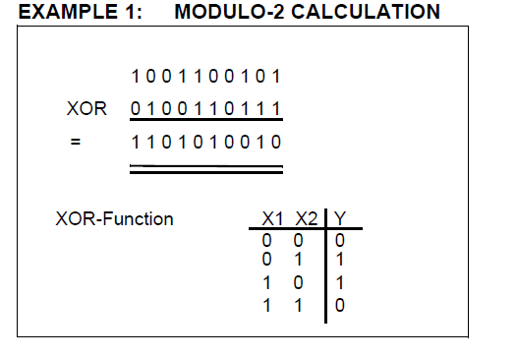

Slide 103
Before we can start calculating the CRC value 1, the message has to be augmented by n-bits, where n is the length of the polynomial.
The CRC-16 polynomial has a length of 16-bits, therefore, 16-bits have to be augmented to the original message.
In this example calculation, the polynomial has a length of 3-bits, therefore, the message has to be extended by three zeros at the end.

Slide 104
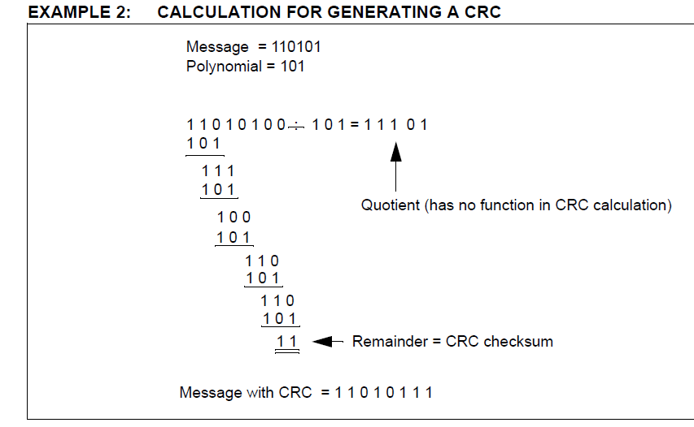

Slide 105
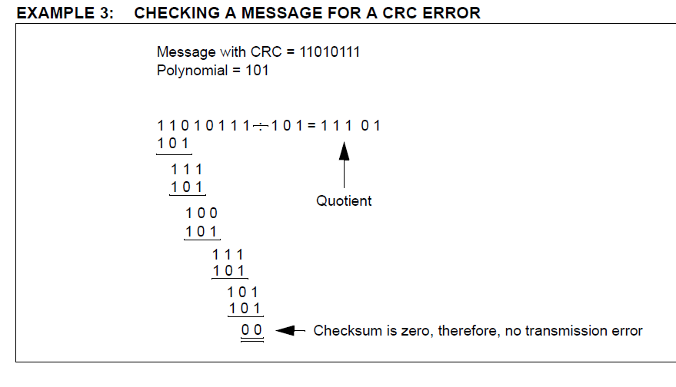

Slide 106
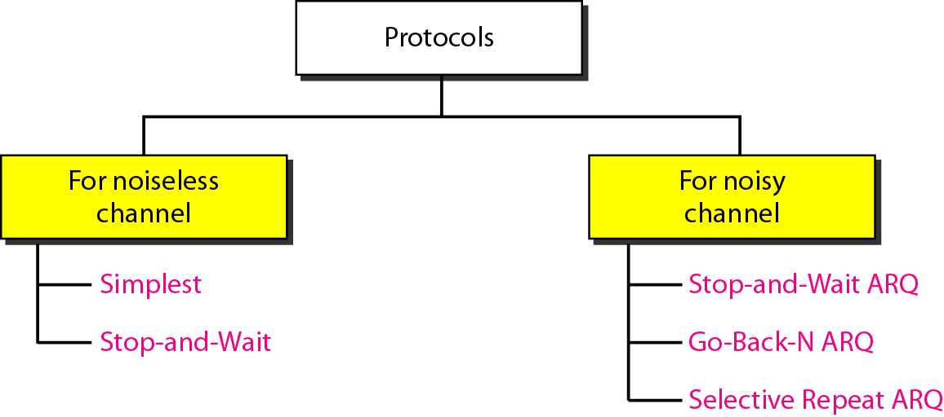

Slide 107
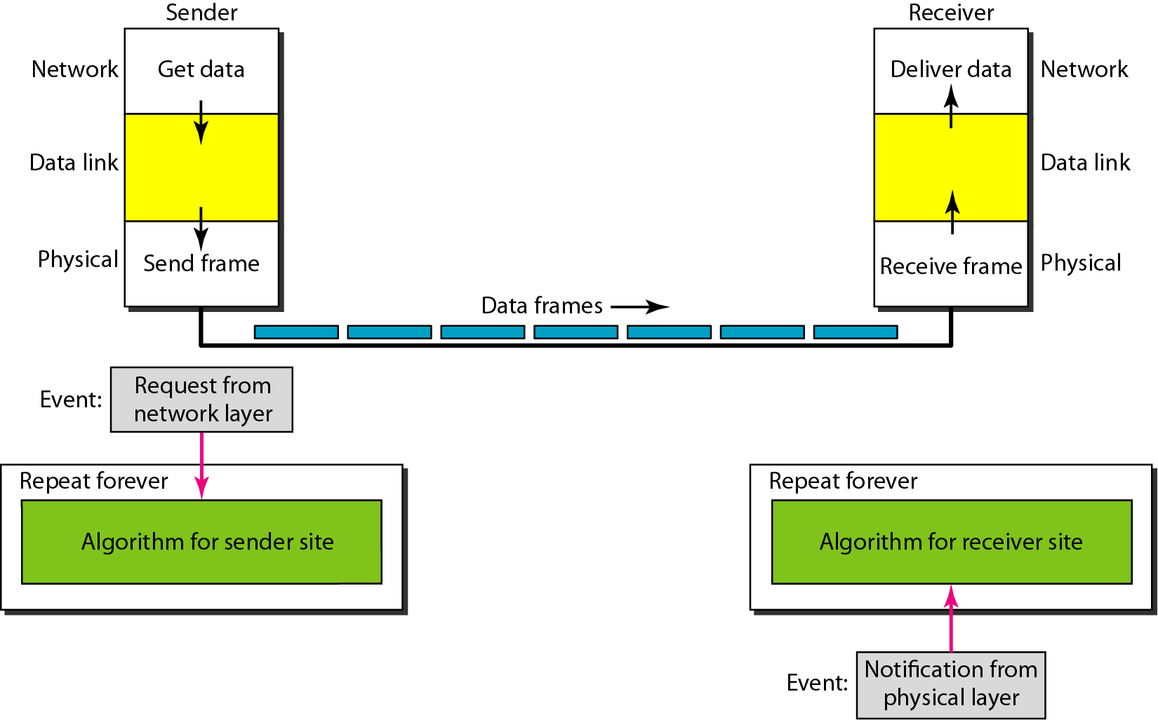
The design of the simplest protocol with no flow or error control

Slide 108
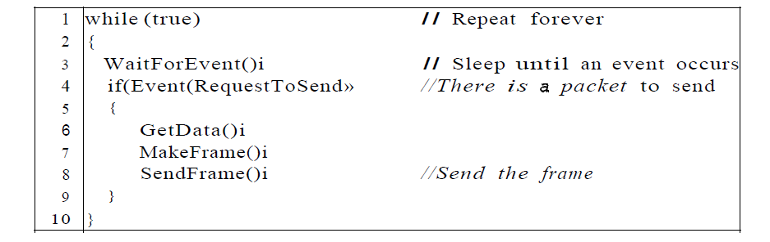

Slide 109
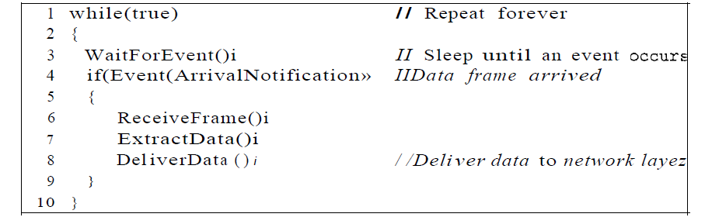

Slide 110
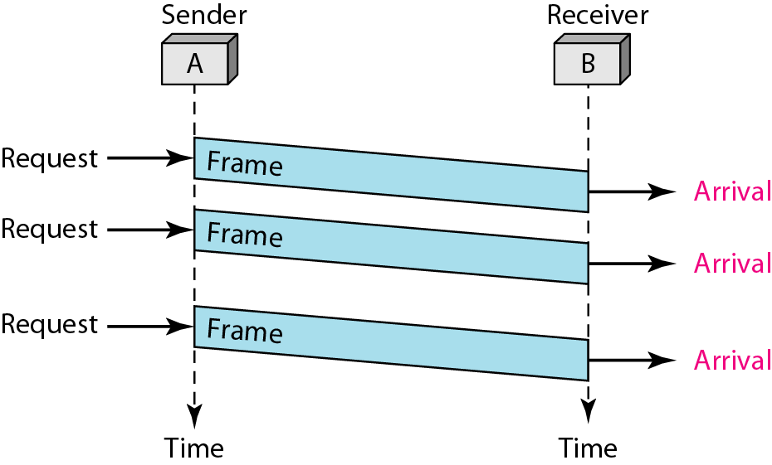

Slide 111
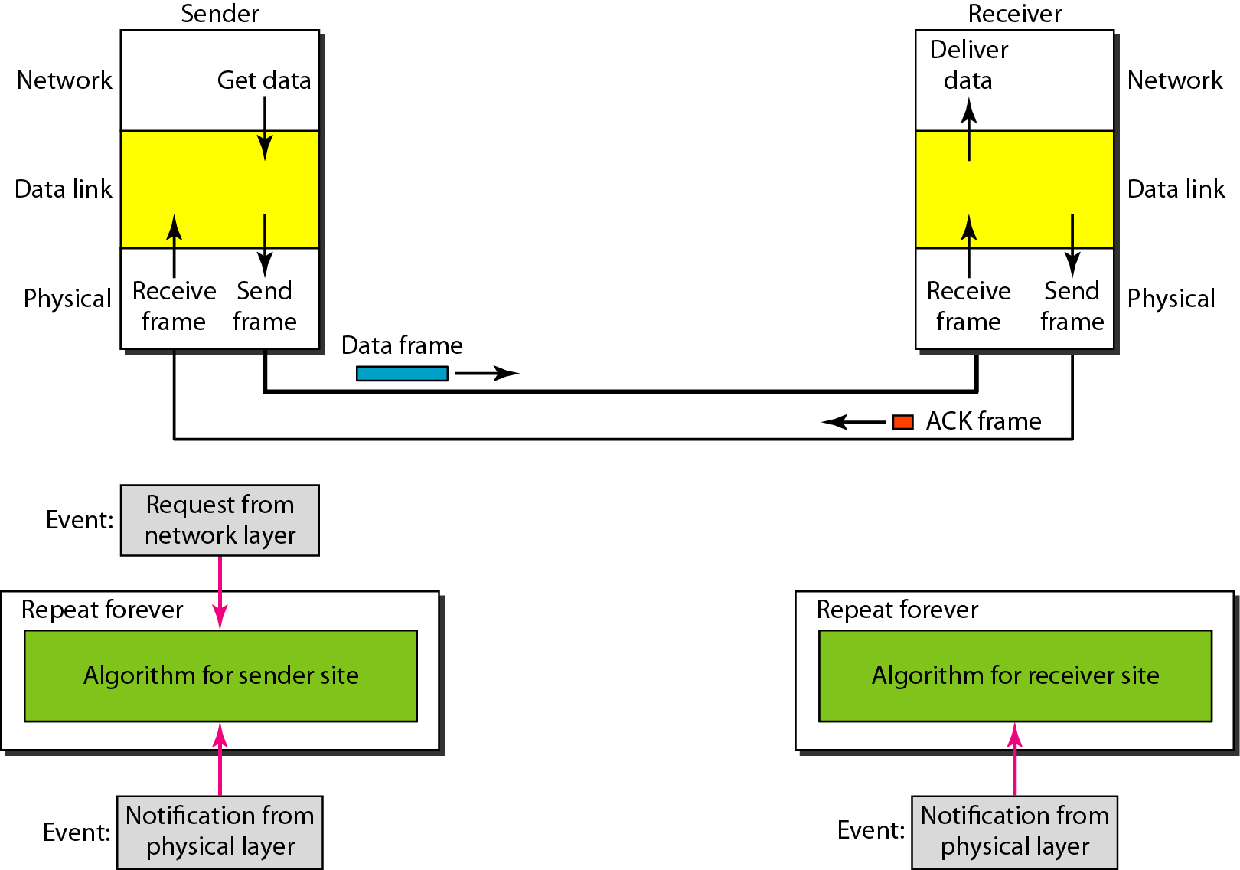
Figure 11.8 Design of Stop-and-Wait Protocol

Slide 112
Algorithm 11.3 Sender-site algorithm for Stop-and-Wait Protocol

Slide 113
Algorithm 11.4 Receiver-site algorithm for Stop-and-Wait Protocol

Slide 114
Example 11.2
Figure 11.9 shows an example of communication using this protocol. It is still very simple. The sender sends one frame and waits for feedback from the receiver. When the ACK arrives, the sender sends the next frame. Note that sending two frames in the protocol involves the sender in four events and the receiver in two events.

Slide 115
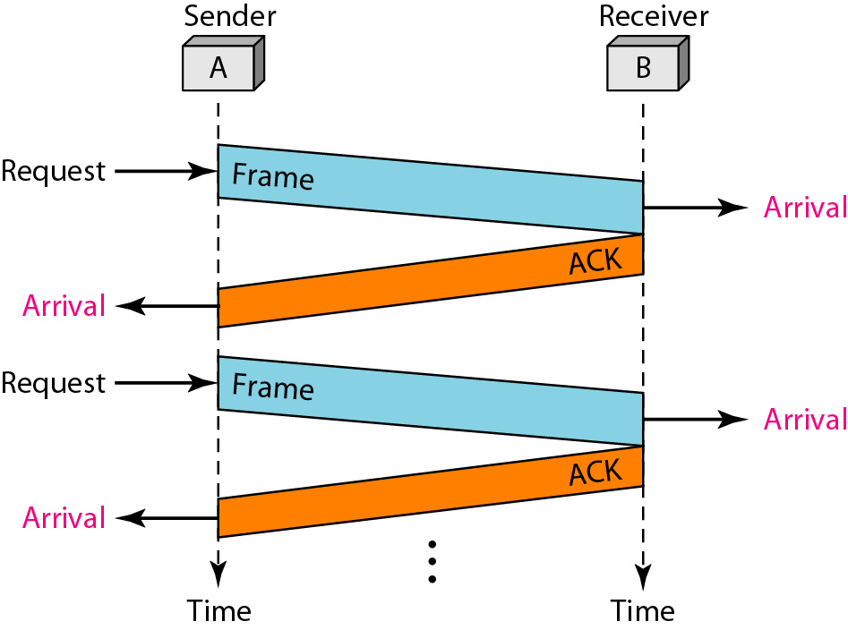
Figure 11.9 Flow diagram for Example 11.2

Slide 116
11-5 NOISY CHANNELS
Although the Stop-and-Wait Protocol gives us an idea of how to add flow control to its predecessor, noiseless channels are nonexistent. We discuss three protocols in this section that use error control.
Topics discussed in this section:
Stop-and-Wait Automatic Repeat Request Go-Back-N Automatic Repeat Request Selective Repeat Automatic Repeat Request

Slide 117
Note
Error correction in Stop-and-Wait ARQ is done by keeping a copy of the sent frame and retransmitting of the frame when the timer expires.

Slide 118
Note
In Stop-and-Wait ARQ, we use sequence numbers to number the frames.
The sequence numbers are based on modulo-2 arithmetic.

Slide 119
Note
In Stop-and-Wait ARQ, the acknowledgment number always announces in modulo-2 arithmetic the sequence number of the next frame expected.

Slide 120
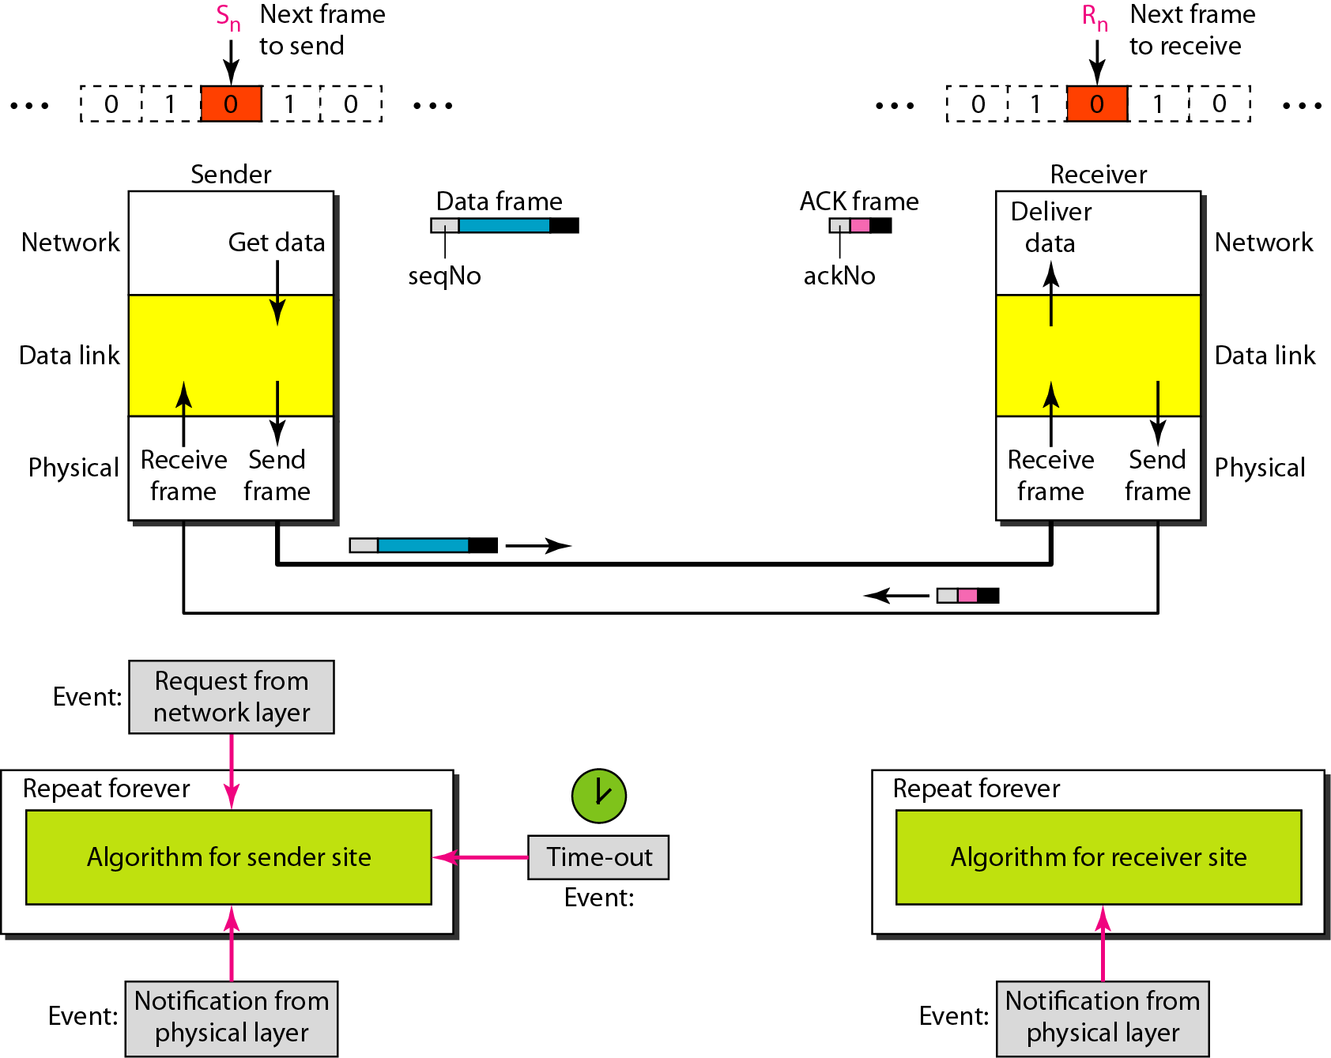
Figure 11.10 Design of the Stop-and-Wait ARQ Protocol

Slide 121
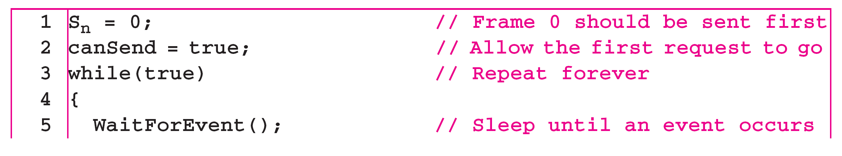
Algorithm 11.5 Sender-site algorithm for Stop-and-Wait ARQ
(continued)

Slide 122
Algorithm 11.5 Sender-site algorithm for Stop-and-Wait ARQ
(continued)

Slide 123
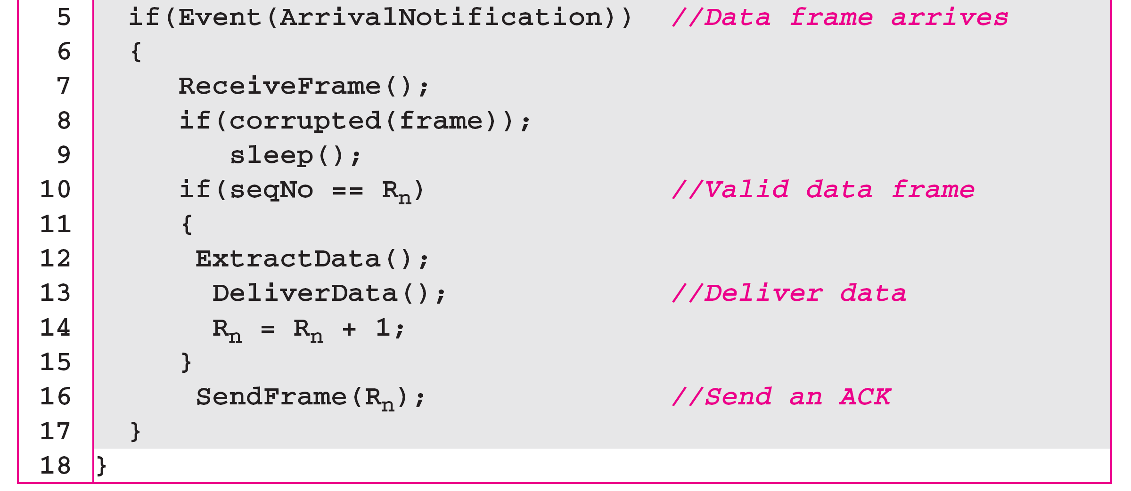
Algorithm 11.6 Receiver-site algorithm for Stop-and-Wait ARQ Protocol

Slide 124
Example 11.3
Figure 11.11 shows an example of Stop-and-Wait ARQ. Frame 0 is sent and acknowledged. Frame 1 is lost and resent after the time-out. The resent frame 1 is acknowledged and the timer stops. Frame 0 is sent and acknowledged, but the acknowledgment is lost. The sender has no idea if the frame or the acknowledgment is lost, so after the time-out, it resends frame 0, which is acknowledged.

Slide 125
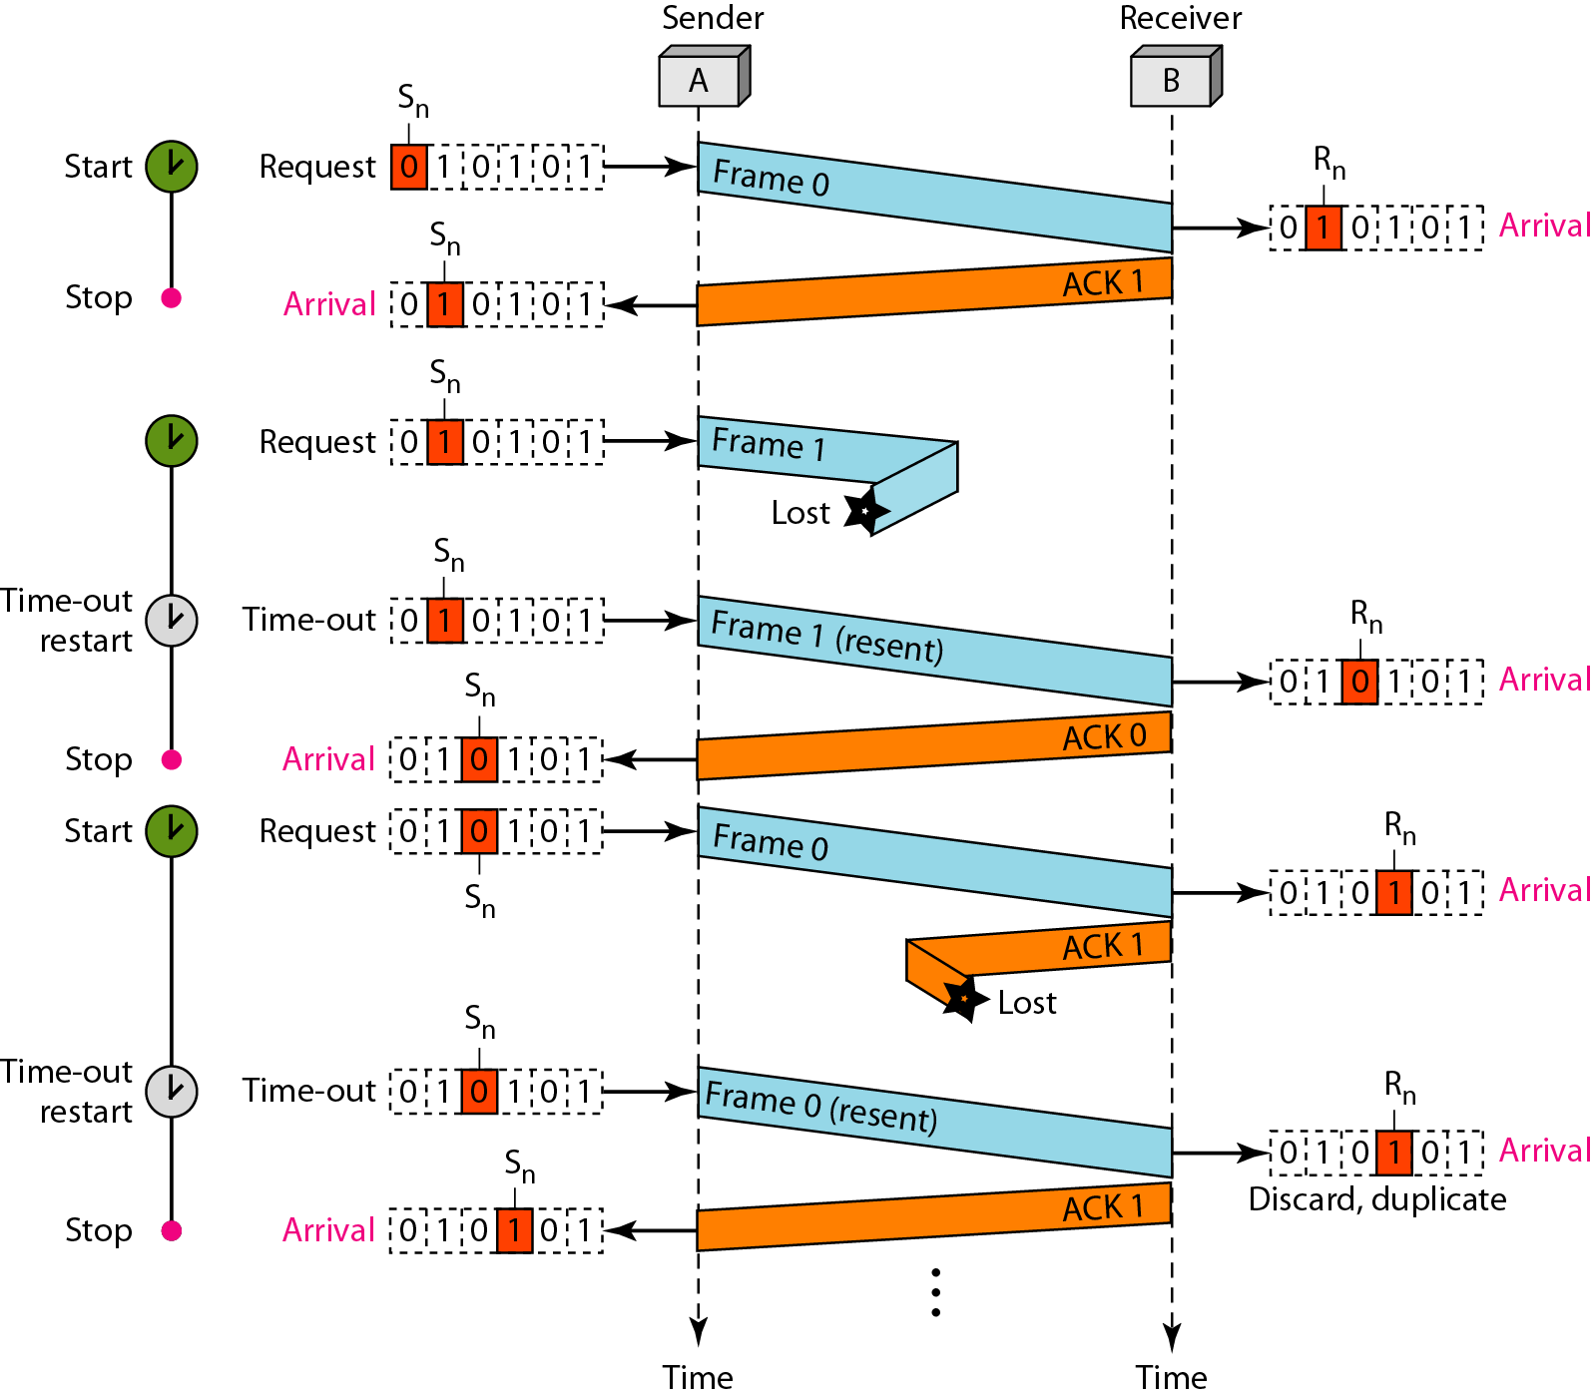
Figure 11.11 Flow diagram for Example 11.3

Slide 126
Example 11.4
Assume that, in a Stop-and-Wait ARQ system, the bandwidth of the line is 1 Mbps, and 1 bit takes 20 ms to make a round trip. What is the bandwidth-delay product? If the system data frames are 1000 bits in length, what is the utilization percentage of the link?
Solution
The bandwidth-delay product is

Slide 127
Example 11.4 (continued)
The system can send 20,000 bits during the time it takes for the data to go from the sender to the receiver and then back again. However, the system sends only 1000 bits. We can say that the link utilization is only 1000/20,000, or 5 percent. For this reason, for a link with a high bandwidth or long delay, the use of Stop-and-Wait ARQ wastes the capacity of the link.

Slide 128
Example 11.5
What is the utilization percentage of the link in Example 11.4 if we have a protocol that can send up to 15 frames before stopping and worrying about the acknowledgments?
Solution
The bandwidth-delay product is still 20,000 bits. The system can send up to 15 frames or 15,000 bits during a round trip. This means the utilization is 15,000/20,000, or 75 percent. Of course, if there are damaged frames, the utilization percentage is much less because frames have to be resent.

Slide 129
Note
In the Go-Back-N Protocol, the sequence numbers are modulo 2^{m},
where m is the size of the sequence number field in bits.

Slide 130
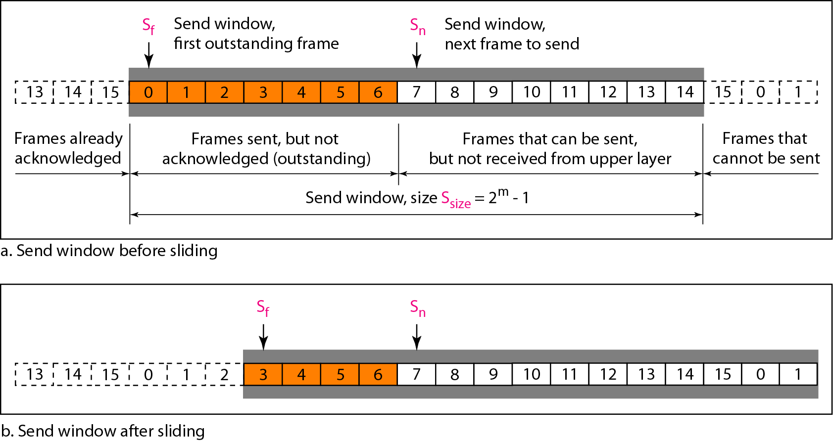
Figure 11.12 Send window for Go-Back-N ARQ

Slide 131
Note
The send window is an abstract concept defining an imaginary box of size 2^{m} − 1 with three variables: Sf, Sn, and S_{size}.

Slide 132
Note
The send window can slide one or more slots when a valid acknowledgment arrives.

Slide 133

Figure 11.13 Receive window for Go-Back-N ARQ

Slide 134
Note
The receive window is an abstract concept defining an imaginary box
of size 1 with one single variable R_{n}. The window slides
when a correct frame has arrived; sliding occurs one slot at a time.

Slide 135

Figure 11.14 Design of Go-Back-N ARQ

Slide 136

Figure 11.15 Window size for Go-Back-N ARQ

Slide 137
Note
In Go-Back-N ARQ, the size of the send window must be less than 2^{m};
the size of the receiver window is always 1.

Slide 138
Algorithm 11.7 Go-Back-N sender algorithm
(continued)

Slide 139

Algorithm 11.7 Go-Back-N sender algorithm
(continued)

Slide 140
Algorithm 11.8 Go-Back-N receiver algorithm

Slide 141
Example 11.6
Figure 11.16 shows an example of Go-Back-N. This is an example of a case where the forward channel is reliable, but the reverse is not. No data frames are lost, but some ACKs are delayed and one is lost. The example also shows how cumulative acknowledgments can help if acknowledgments are delayed or lost. After initialization, there are seven sender events. Request events are triggered by data from the network layer; arrival events are triggered by acknowledgments from the physical layer. There is no time-out event here because all outstanding frames are acknowledged before the timer expires. Note that although ACK 2 is lost, ACK 3 serves as both ACK 2 and ACK 3.

Slide 142

Figure 11.16 Flow diagram for Example 11.6

Slide 143
Example 11.7
Figure 11.17 shows what happens when a frame is lost. Frames 0, 1, 2, and 3 are sent. However, frame 1 is lost. The receiver receives frames 2 and 3, but they are discarded because they are received out of order. The sender receives no acknowledgment about frames 1, 2, or 3. Its timer finally expires. The sender sends all outstanding frames (1, 2, and 3) because it does not know what is wrong. Note that the resending of frames 1, 2, and 3 is the response to one single event. When the sender is responding to this event, it cannot accept the triggering of other events. This means that when ACK 2 arrives, the sender is still busy with sending frame 3.

Slide 144
Example 11.7 (continued)
The physical layer must wait until this event is completed and the data link layer goes back to its sleeping state. We have shown a vertical line to indicate the delay. It is the same story with ACK 3; but when ACK 3 arrives, the sender is busy responding to ACK 2. It happens again when ACK 4 arrives. Note that before the second timer expires, all outstanding frames have been sent and the timer is stopped.

Slide 145

Figure 11.17 Flow diagram for Example 11.7

Slide 146
Note
Stop-and-Wait ARQ is a special case of Go-Back-N ARQ in which the size of the send window is 1.

Slide 147

Figure 11.18 Send window for Selective Repeat ARQ

Slide 148

Figure 11.19 Receive window for Selective Repeat ARQ

Slide 149

Figure 11.20 Design of Selective Repeat ARQ

Slide 150

Figure 11.21 Selective Repeat ARQ, window size

Slide 151
Note
In Selective Repeat ARQ, the size of the sender and receiver window
must be at most one-half of 2^{m}.

Slide 152
Algorithm 11.9 Sender-site Selective Repeat algorithm
(continued)

Slide 153
Algorithm 11.9 Sender-site Selective Repeat algorithm
(continued)
(continued)

Slide 154
Algorithm 11.9 Sender-site Selective Repeat algorithm
(continued)

Slide 155
Algorithm 11.10 Receiver-site Selective Repeat algorithm

Slide 156
Algorithm 11.10 Receiver-site Selective Repeat algorithm

Slide 157

Figure 11.22 Delivery of data in Selective Repeat ARQ

Slide 158
Example 11.8
This example is similar to Example 11.3 in which frame 1 is lost. We show how Selective Repeat behaves in this case. Figure 11.23 shows the situation. One main difference is the number of timers. Here, each frame sent or resent needs a timer, which means that the timers need to be numbered (0, 1, 2, and 3). The timer for frame 0 starts at the first request, but stops when the ACK for this frame arrives. The timer for frame 1 starts at the second request, restarts when a NAK arrives, and finally stops when the last ACK arrives. The other two timers start when the corresponding frames are sent and stop at the last arrival event.

Slide 159
Example 11.8 (continued)
At the receiver site we need to distinguish between the acceptance of a frame and its delivery to the network layer. At the second arrival, frame 2 arrives and is stored and marked, but it cannot be delivered because frame 1 is missing. At the next arrival, frame 3 arrives and is marked and stored, but still none of the frames can be delivered. Only at the last arrival, when finally a copy of frame 1 arrives, can frames 1, 2, and 3 be delivered to the network layer. There are two conditions for the delivery of frames to the network layer: First, a set of consecutive frames must have arrived. Second, the set starts from the beginning of the window.

Slide 160
Example 11.8 (continued)
Another important point is that a NAK is sent after the second arrival, but not after the third, although both situations look the same. The reason is that the protocol does not want to crowd the network with unnecessary NAKs and unnecessary resent frames. The second NAK would still be NAK1 to inform the sender to resend frame 1 again; this has already been done. The first NAK sent is remembered (using the nakSent variable) and is not sent again until the frame slides. A NAK is sent once for each window position and defines the first slot in the window.

Slide 161
Example 11.8 (continued)
The next point is about the ACKs. Notice that only two ACKs are sent here. The first one acknowledges only the first frame; the second one acknowledges three frames. In Selective Repeat, ACKs are sent when data are delivered to the network layer. If the data belonging to n frames are delivered in one shot, only one ACK is sent for all of them.

Slide 162

Figure 11.23 Flow diagram for Example 11.8

Slide 163

Figure 11.24 Design of piggybacking in Go-Back-N ARQ

Slide 164
11-6 HDLC
High-level Data Link Control (HDLC) is a bit-oriented protocol for communication over point-to-point and multipoint links. It implements the ARQ mechanisms we discussed in this chapter.
Topics discussed in this section:
Configurations and Transfer Modes Frames Control Field

Slide 165
HDLC provides both connection-oriented and connectionless service.
HDLC frames can be transmitted over synchronous or asynchronous serial communication links
framing: On synchronous links, this is done with bit stuffing.
On synchronous links : byte stuffying

Slide 166

Figure 11.25 Normal response mode

Slide 167

Figure 11.26 Asynchronous balanced mode

Slide 168
There are three fundamental types of HDLC frames.
Information frames, or I-frames, transport user data from the network layer. In addition they can also include flow and error control information piggybacked on data.
Supervisory Frames, or S-frames, are used for flow and error control whenever piggybacking is impossible or inappropriate, such as when a station does not have data to send. S-frames do not have information fields.
Unnumbered frames, or U-frames, are used for various miscellaneous purposes, including link management. Some U-frames contain an information field, depending on the type.

Slide 169

Figure 11.27 HDLC frames

Slide 170

Figure 11.28 Control field format for the different frame types

Slide 171
Poll/Final is a single bit with two names. It is called Poll when set by the primary station to obtain a response from a secondary station, and Final when set by the secondary station to indicate a response or the end of transmission. In all other cases, the bit is clear.

Slide 172

Table 11.1 U-frame control command and response

Slide 173
LAPB
LAPB is a bit-oriented protocol derived from HDLC.
Ensures that frames are error free and in the right sequence
It can be used as a Data Link Layer protocol implementing the connection-mode data link service in the OSI Reference Model
X.25 is an ITU-T standard protocol suite for packet switched wide area network (WAN) communication
LAPB is used to manage communication and packet framing between data terminal equipment (DTE) and the data circuit-terminating equipment (DCE) devices in the X.25 protocol stack

Slide 174
LAPD
Link Access Procedures, D channel
LAPD is the second layer protocol on the ISDN protocol stack in the D channel (the ISDN channel in which the control and signalling information is carried).
LAPD standards are specified in ITU-T Q.920 and Q.921.
Its development was heavily based on High-Level Data Link Control. Procedures, D channel

Slide 175
Example 11.9
Figure 11.29 shows how U-frames can be used for connection establishment and connection release. Node A asks for a connection with a set asynchronous balanced mode (SABM) frame; node B gives a positive response with an unnumbered acknowledgment (UA) frame. After these two exchanges, data can be transferred between the two nodes (not shown in the figure). After data transfer, node A sends a DISC (disconnect) frame to release the connection; it is confirmed by node B responding with a UA (unnumbered acknowledgment).

Slide 176

Figure 11.29 Example of connection and disconnection

Slide 177
Example 11.10
Figure 11.30 shows an exchange using piggybacking. Node A begins the exchange of information with an I-frame numbered 0 followed by another I-frame numbered 1. Node B piggybacks its acknowledgment of both frames onto an I-frame of its own. Node B’s first I-frame is also numbered 0 [N(S) field] and contains a 2 in its N(R) field, acknowledging the receipt of A’s frames 1 and 0 and indicating that it expects frame 2 to arrive next. Node B transmits its second and third I-frames (numbered 1 and 2) before accepting further frames from node A.

Slide 178
Example 11.10 (continued)
Its N(R) information, therefore, has not changed: B frames 1 and 2 indicate that node B is still expecting A’s frame 2 to arrive next. Node A has sent all its data. Therefore, it cannot piggyback an acknowledgment onto an I-frame and sends an S-frame instead. The RR code indicates that A is still ready to receive. The number 3 in the N(R) field tells B that frames 0, 1, and 2 have all been accepted and that A is now expecting frame number 3.

Slide 179

Figure 11.30 Example of piggybacking without error

Slide 180
Example 11.11
Figure 11.31 shows an exchange in which a frame is lost. Node B sends three data frames (0, 1, and 2), but frame 1 is lost. When node A receives frame 2, it discards it and sends a REJ frame for frame 1. Note that the protocol being used is Go-Back-N with the special use of an REJ frame as a NAK frame. The NAK frame does two things here: It confirms the receipt of frame 0 and declares that frame 1 and any following frames must be resent. Node B, after receiving the REJ frame, resends frames 1 and 2. Node A acknowledges the receipt by sending an RR frame (ACK) with acknowledgment number 3.

Slide 181

Figure 11.31 Example of piggybacking with error

Slide 182
11-7 POINT-TO-POINT PROTOCOL
Although HDLC is a general protocol that can be used for both point-to-point and multipoint configurations, one of the most common protocols for point-to-point access is the Point-to-Point Protocol (PPP). PPP is a byte-oriented protocol.
Topics discussed in this section:
Framing
Transition Phases
Multiplexing
Multilink PPP

Slide 183

Figure 11.32 PPP frame format

Slide 184
Note
PPP is a byte-oriented protocol using byte stuffing with the escape byte 01111101.

Slide 185

Figure 11.33 Transition phases

Slide 186

Figure 11.34 Multiplexing in PPP

Slide 187

Figure 11.35 LCP packet encapsulated in a frame

Slide 188

Table 11.2 LCP packets

Slide 189
Table 11.3 Common options

Slide 190

Figure 11.36 PAP packets encapsulated in a PPP frame

Slide 191

Figure 11.37 CHAP packets encapsulated in a PPP frame

Slide 192

Figure 11.38 IPCP packet encapsulated in PPP frame

Slide 193
Table 11.4 Code value for IPCP packets

Slide 194

Figure 11.39 IP datagram encapsulated in a PPP frame

Slide 195

Figure 11.40 Multilink PPP

Slide 196
Example 11.12
Let us go through the phases followed by a network layer packet as it is transmitted through a PPP connection. Figure 11.41 shows the steps. For simplicity, we assume unidirectional movement of data from the user site to the system site (such as sending an e-mail through an ISP).
The first two frames show link establishment. We have chosen two options (not shown in the figure): using PAP for authentication and suppressing the address control fields. Frames 3 and 4 are for authentication. Frames 5 and 6 establish the network layer connection using IPCP.

Slide 197
Example 11.12 (continued)
The next several frames show that some IP packets are encapsulated in the PPP frame. The system (receiver) may have been running several network layer protocols, but it knows that the incoming data must be delivered to the IP protocol because the NCP protocol used before the data transfer was IPCP.
After data transfer, the user then terminates the data link connection, which is acknowledged by the system. Of course the user or the system could have chosen to terminate the network layer IPCP and keep the data link layer running if it wanted to run another NCP protocol.

Slide 198

Figure 11.41 An example

Slide 199

Figure 11.41 An example (continued)

Slide 200
Error Detection Codes (1)
Hamming codes.
Binary convolutional codes.
Reed-Solomon codes.
Low-Density Parity Check codes.

Slide 201

Error Detection Codes (2)
Example of an (11, 7) Hamming code correcting a single-bit error.

Slide 202
Error Detection Codes (3)
The NASA binary convolutional code used in 802.11.

Slide 203
Error-Detecting Codes (1)
Linear, systematic block codes
Parity.
Checksums.
Cyclic Redundancy Checks (CRCs).

Slide 204

Error-Detecting Codes (2)
Interleaving of parity bits to detect a burst error.

Slide 205

Error-Detecting Codes (3)
Example calculation of the CRC

Slide 206
Elementary Data Link Protocols (1)
Utopian Simplex Protocol
Simplex Stop-and-Wait Protocol
Error-Free Channel
Simplex Stop-and-Wait Protocol
Noisy Channel

Slide 207

Elementary Data Link Protocols (2)
Implementation of the physical, data link, and network layers.

Slide 208

Elementary Data Link Protocols (3)
Some definitions needed in the protocols to follow. These definitions are located in the file protocol.h.
. . .

Slide 209

Elementary Data Link Protocols (4)
Some definitions needed in the protocols to follow. These definitions are located in the file protocol.h.
. . .

Slide 210

Elementary Data Link Protocols (5)
Some definitions needed in the protocols to follow. These definitions are located in the file protocol.h.

Slide 211

Utopian Simplex Protocol (1)
. . .
A utopian simplex protocol.

Slide 212

Utopian Simplex Protocol (2)
A utopian simplex protocol.

Slide 213

Simplex Stop-and-Wait Protocol for a Noisy Channel (1)
. . .
A simplex stop-and-wait protocol.

Slide 214

Simplex Stop-and-Wait Protocol for a Noisy Channel (2)
A simplex stop-and-wait protocol.

Slide 215

Sliding Window Protocols (1)
A positive acknowledgement with retransmission protocol.
. . .

Slide 216

Sliding Window Protocols (2)
A positive acknowledgement with retransmission protocol.
. . .

Slide 217

Sliding Window Protocols (3)
A positive acknowledgement with retransmission protocol.

Slide 218

Sliding Window Protocols (4)
A sliding window of size 1, with a 3-bit sequence number. (a) Initially. (b) After the first frame has been sent.

Slide 219



Sliding Window Protocols (5)
A sliding window of size 1, with a 3-bit sequence number
(c) After the first frame has been received. (d) After the first acknowledgement has been received.

Slide 220

One-Bit Sliding Window Protocol (1)
. . .
A 1-bit sliding window protocol.

Slide 221

One-Bit Sliding Window Protocol (2)
. . .
A 1-bit sliding window protocol.

Slide 222

One-Bit Sliding Window Protocol (3)
A 1-bit sliding window protocol.

Slide 223

One-Bit Sliding Window Protocol (4)
Two scenarios for protocol 4. (a) Normal case. (b) Abnormal
case. The notation is (seq, ack, packet number). An asterisk indicates where a network layer accepts a packet

Slide 224

Protocol Using Go-Back-N (1)
Pipelining and error recovery. Effect of an error when
(a) receiver’s window size is 1

Slide 225

Protocol Using Go-Back-N (2)
Pipelining and error recovery. Effect of an error when
(b) receiver’s window size is large.

Slide 226

Protocol Using Go-Back-N (3)
A sliding window protocol using go-back-n.
. . .

Slide 227

Protocol Using Go-Back-N (4)
A sliding window protocol using go-back-n.
. . .

Slide 228

Protocol Using Go-Back-N (5)
A sliding window protocol using go-back-n.
. . .

Slide 229

Protocol Using Go-Back-N (6)
A sliding window protocol using go-back-n.
. . .

Slide 230

Protocol Using Go-Back-N (7)
A sliding window protocol using go-back-n.
. . .

Slide 231

Protocol Using Go-Back-N (8)
A sliding window protocol using go-back-n.
. . .

Slide 232

Protocol Using Go-Back-N (9)
A sliding window protocol using go-back-n.

Slide 233

Protocol Using Go-Back-N (10)
Simulation of multiple timers in software. (a) The queued timeouts (b) The situation after the first timeout has expired.

Slide 234

Protocol Using Selective Repeat (1)
A sliding window protocol using selective repeat.
. . .

Slide 235

Protocol Using Selective Repeat (2)
A sliding window protocol using selective repeat.
. . .

Slide 236

Protocol Using Selective Repeat (3)
A sliding window protocol using selective repeat.
. . .

Slide 237

Protocol Using Selective Repeat (4)
A sliding window protocol using selective repeat.
. . .

Slide 238

Protocol Using Selective Repeat (5)
A sliding window protocol using selective repeat.
. . .

Slide 239

Protocol Using Selective Repeat (6)
A sliding window protocol using selective repeat.
. . .

Slide 240

Protocol Using Selective Repeat (7)
A sliding window protocol using selective repeat.
. . .

Slide 241

Protocol Using Selective Repeat (8)
A sliding window protocol using selective repeat.
. . .

Slide 242

Protocol Using Selective Repeat (9)
A sliding window protocol using selective repeat.

Slide 243

Protocol Using Selective Repeat (10)
Initial situation with a window of size7
After 7 frames sent and received but not acknowledged.
Initial situation with a window size of 4.
After 4 frames sent and received but not acknowledged.

Slide 244
Example Data Link Protocols
Packet over SONET
ADSL (Asymmetric Digital Subscriber Loop)

Slide 245

Packet over SONET (1)
Packet over SONET. (a) A protocol stack. (b) Frame relationships

Slide 246
Packet over SONET (2)
PPP Features
Separate packets, error detection
Link Control Protocol
Network Control Protocol

Slide 247

Packet over SONET (3)
The PPP full frame format for unnumbered mode operation

Slide 248

Packet over SONET (4)
State diagram for bringing a PPP link up and down

Slide 249

ADSL (Asymmetric Digital Subscriber Loop) (1)
ADSL protocol stacks.

Slide 250

ADSL (Asymmetric Digital Subscriber Loop) (1)
AAL5 frame carrying PPP data

Slide 251
End
Chapter 3

Slide 252

Figure 11.2 Byte stuffing and unstuffing

Slide 253

Figure 11.3 A frame in a bit-oriented protocol

Slide 254

Figure 11.4 Bit stuffing and unstuffing

Slide 255
FRAMING
The data link layer needs to pack bits into frames, so that each frame is distinguishable from another.
Our postal system practices a type of framing.

